Slide 1
Hacking on Azure
With Node.js on Azure Websites
@DanielLarsenNZ

Slide 2
This talk
“Hacking”
Spotify Web API
Azure Websites + Node.js
Azure WebJobs + C#

Slide 3
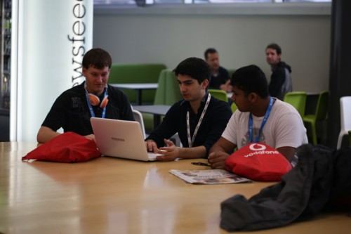

http://hackakl.org.nz/
Notes:
Hacking is: “The act of engaging in programming in a spirit of playfulness and exploration.
Hacker is: “A person who enjoys exploring the details of programmable systems and stretching their capabilities.
“Hacking entails some form of excellence, for example exploring the limits of what is possible, thereby doing something exciting and meaningful.

Slide 4
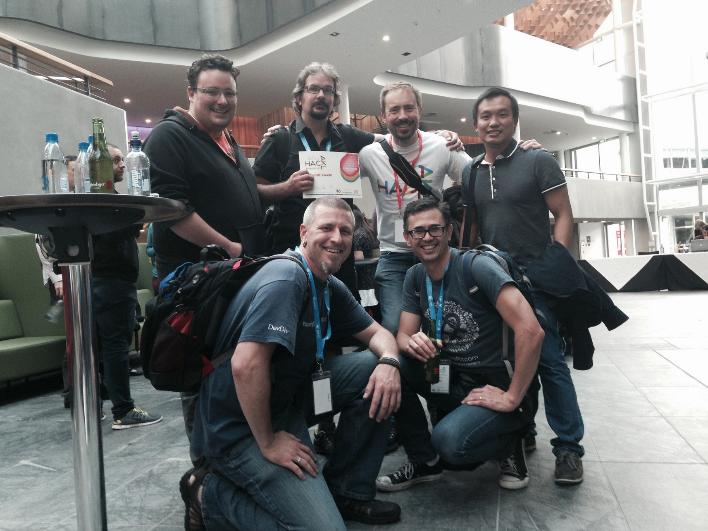

Slide 5
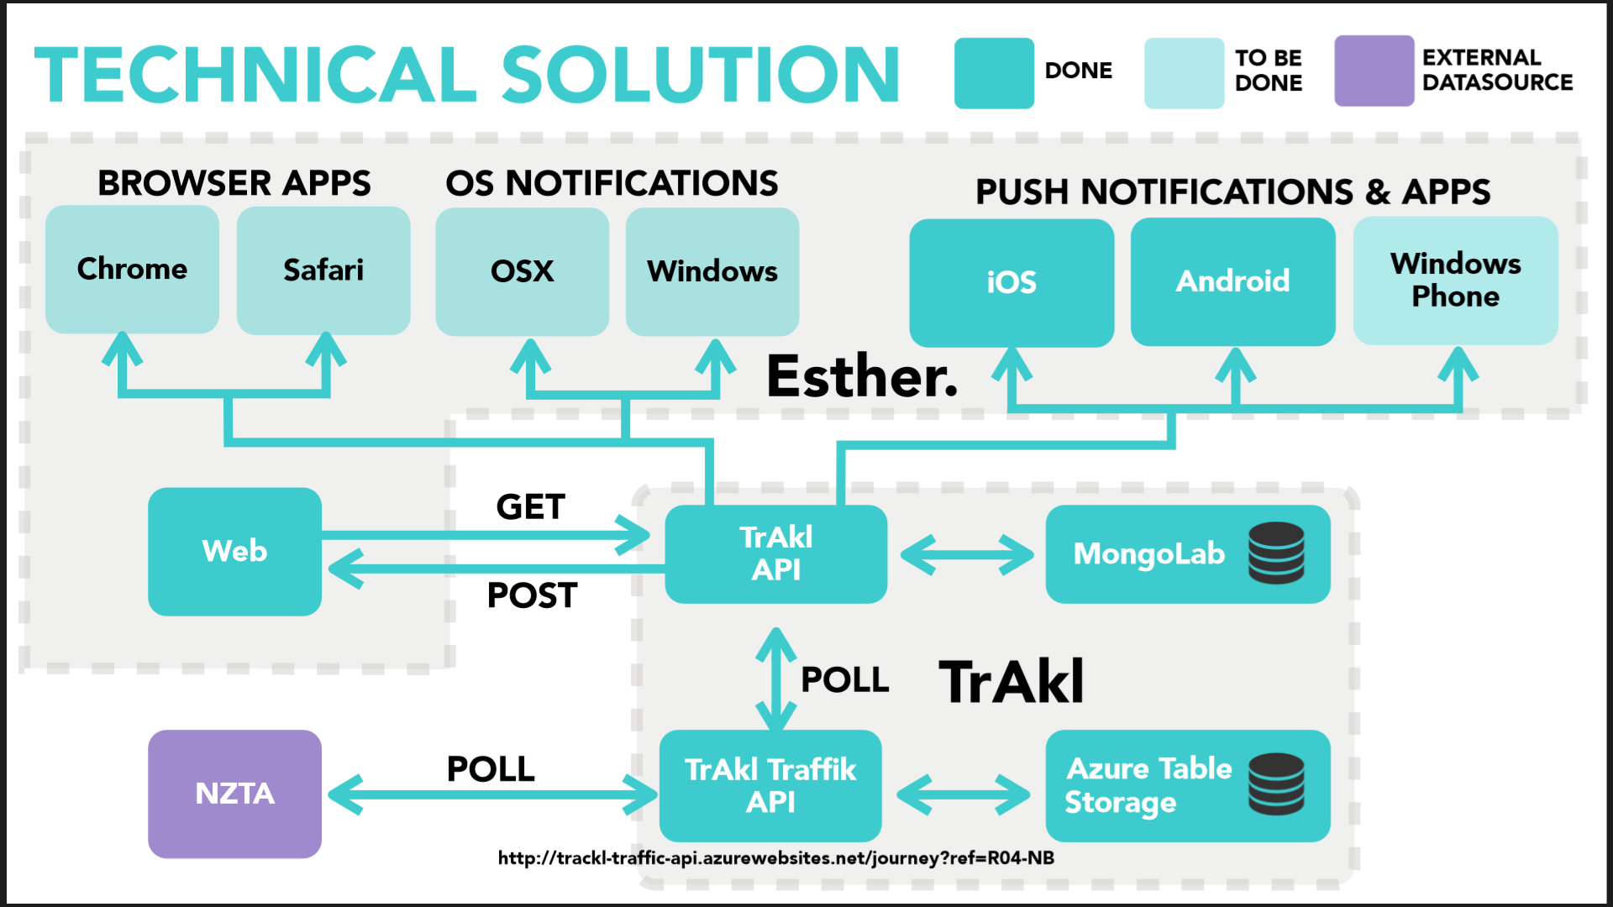

Slide 6
Demo
Node.js + NTVS + Azure Websites

Slide 7
Spotify Web API
https://developer.spotify.com

Slide 8
Demos
https://developer.spotify.com
http://lab.possan.se/thirtify
http://static.echonest.com/enspex/
http://music.xbox.com/Developer

Slide 9
HERE

Slide 10
Hacking on Azure Websites + Node.js
And the Spotify Web API and Queue Storage

Slide 11
Feature map
Create a Jukebox
Import Spotify Playlists
Play

Slide 12
http://hackingon.azurewebsites.net/

Slide 13
Architecture phase 1
Browser client (Angular.js)
Azure Website
(Node.js)
Spotify Web API
Queue Storage

Slide 14
Da codez

Slide 15
Azure WebJobs + C#

Slide 16
Architecture phase 2
Browser client (Angular.js)
Azure Website
(Node.js)
Spotify Web API
Queue Storage
Table Storage
Azure WebJob
(C#)

Slide 17
Codez

Slide 18
Recap
“Hacking”
Spotify Web API
Azure Websites + Node.js
Azure WebJobs + C#

Slide 19
What I didn’t talk about
New Relic
Newman
GitHub deploy
Kudu
Edge.js
CoreCLR, OWIN, Density
Azure costs
Visual Studio Monaco
Lean

Slide 20
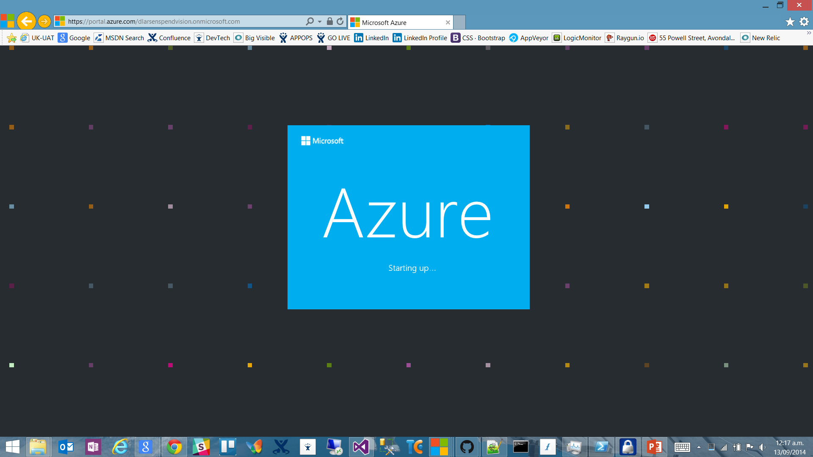

Slide 21
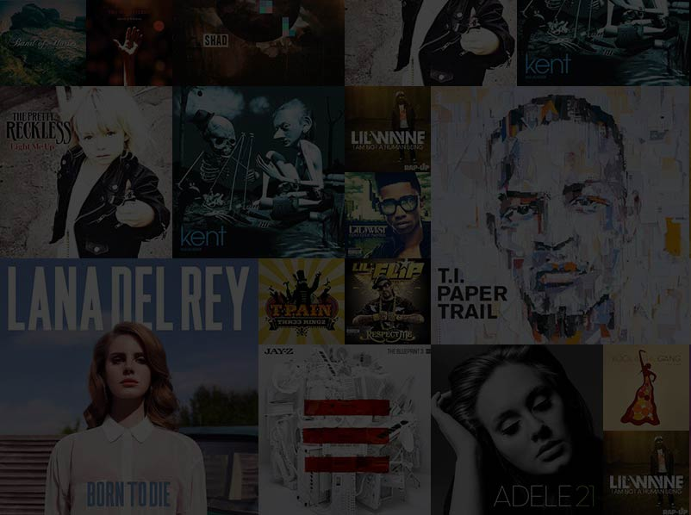

Slide 22
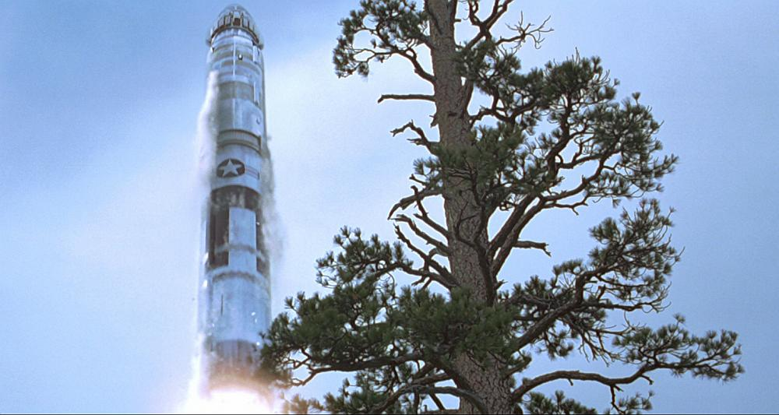
http://en.memory-alpha.org/wiki/Phoenix

Slide 23

By NASA [Public domain], via Wikimedia Commons http://commons.wikimedia.org/wiki/File%3AApollo_11_Earth.jpg

Slide 24
Chur!
Daniel Larsen
@DanielLarsenNZ
https://github.com/DanielLarsenNZ/Hacking-on-Azure

Slide 25
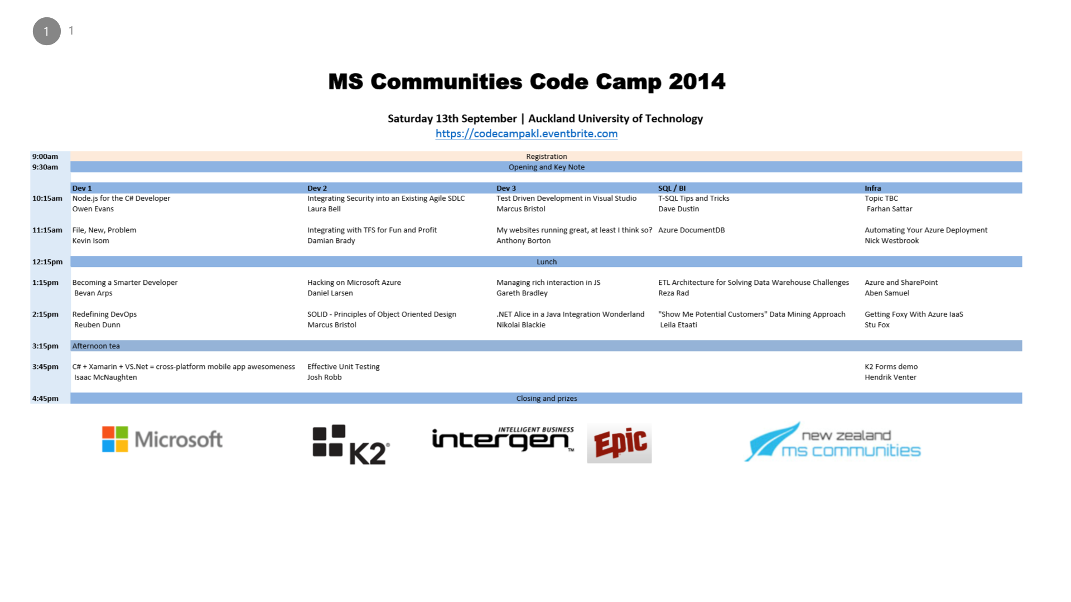

Slide 26
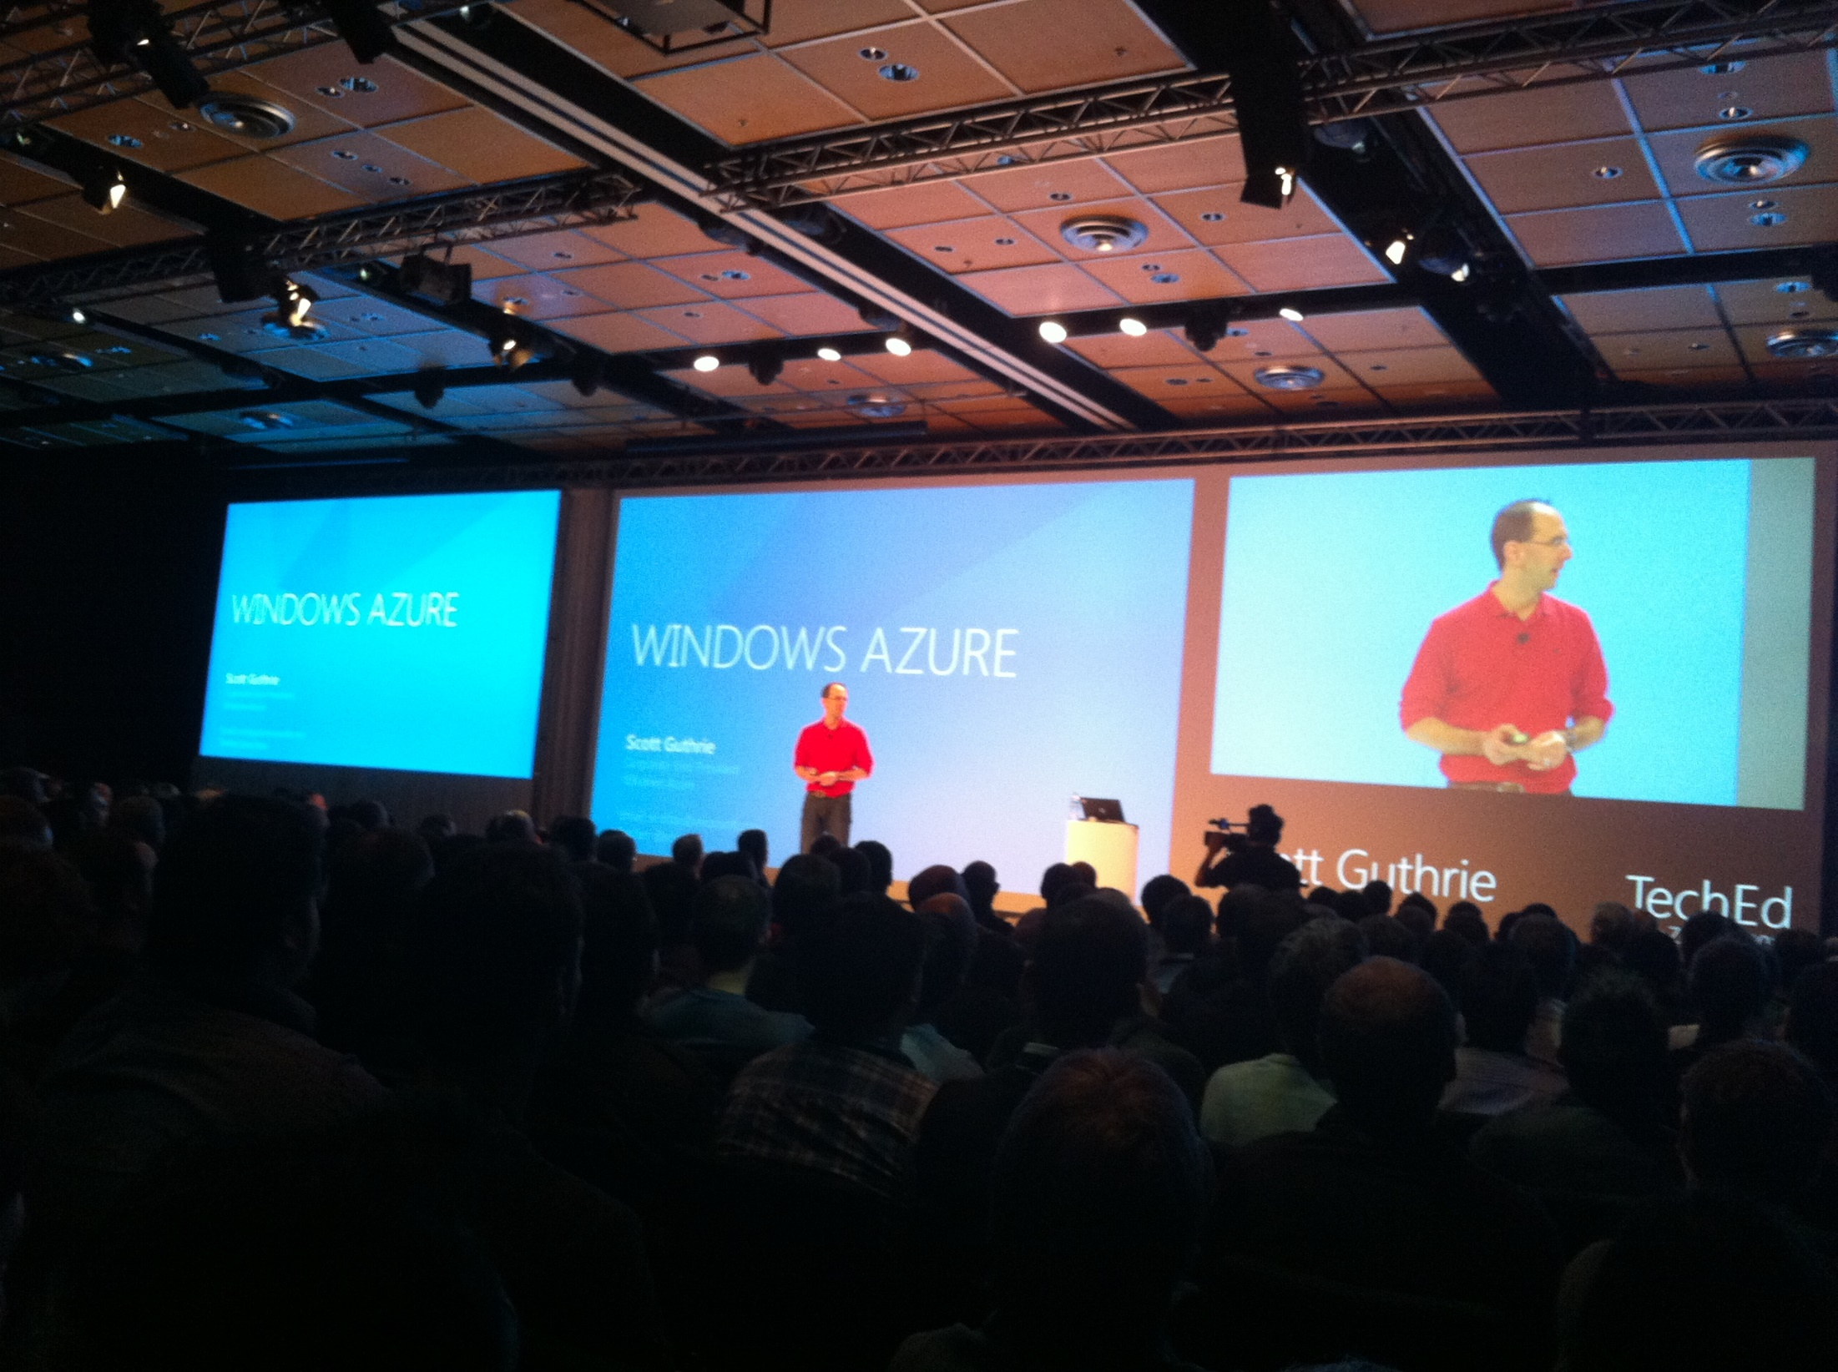

Slide 28
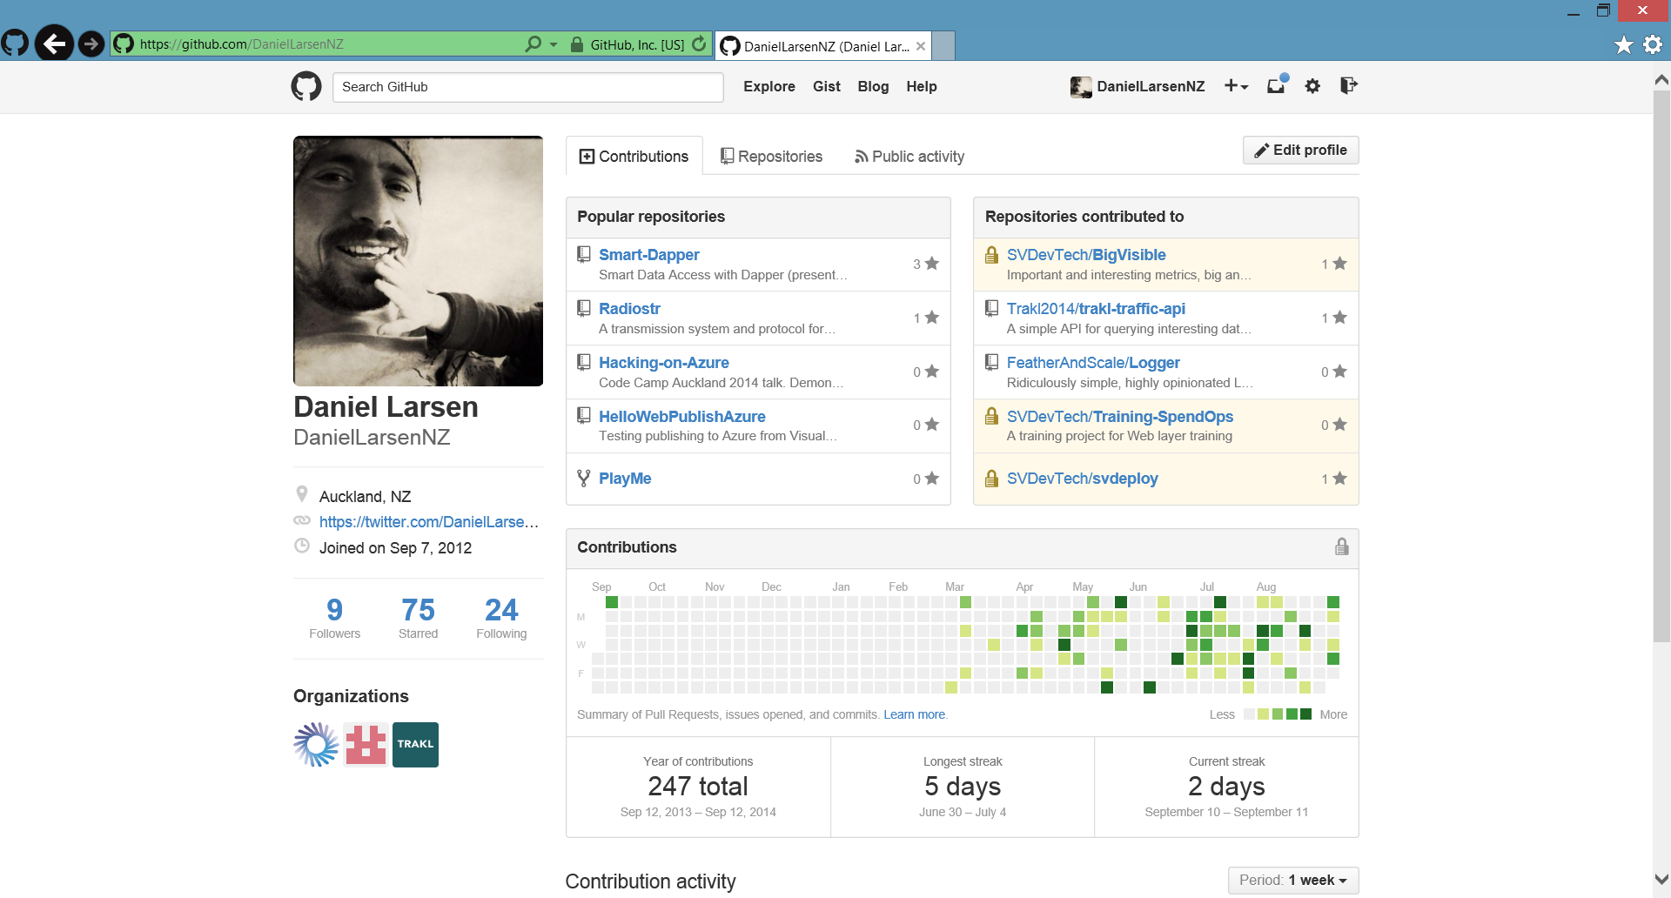

Slide 29
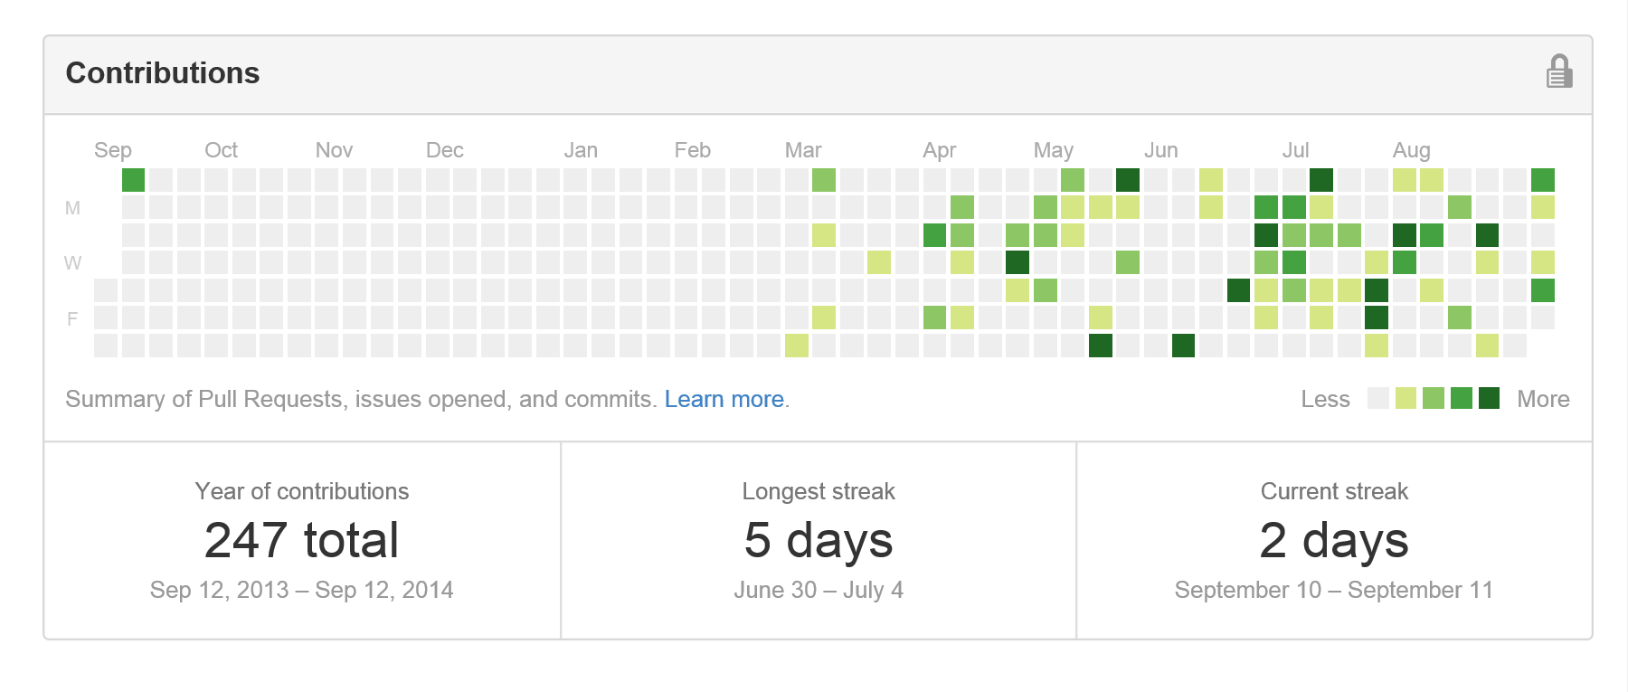
Contribution addiction

Slide 30
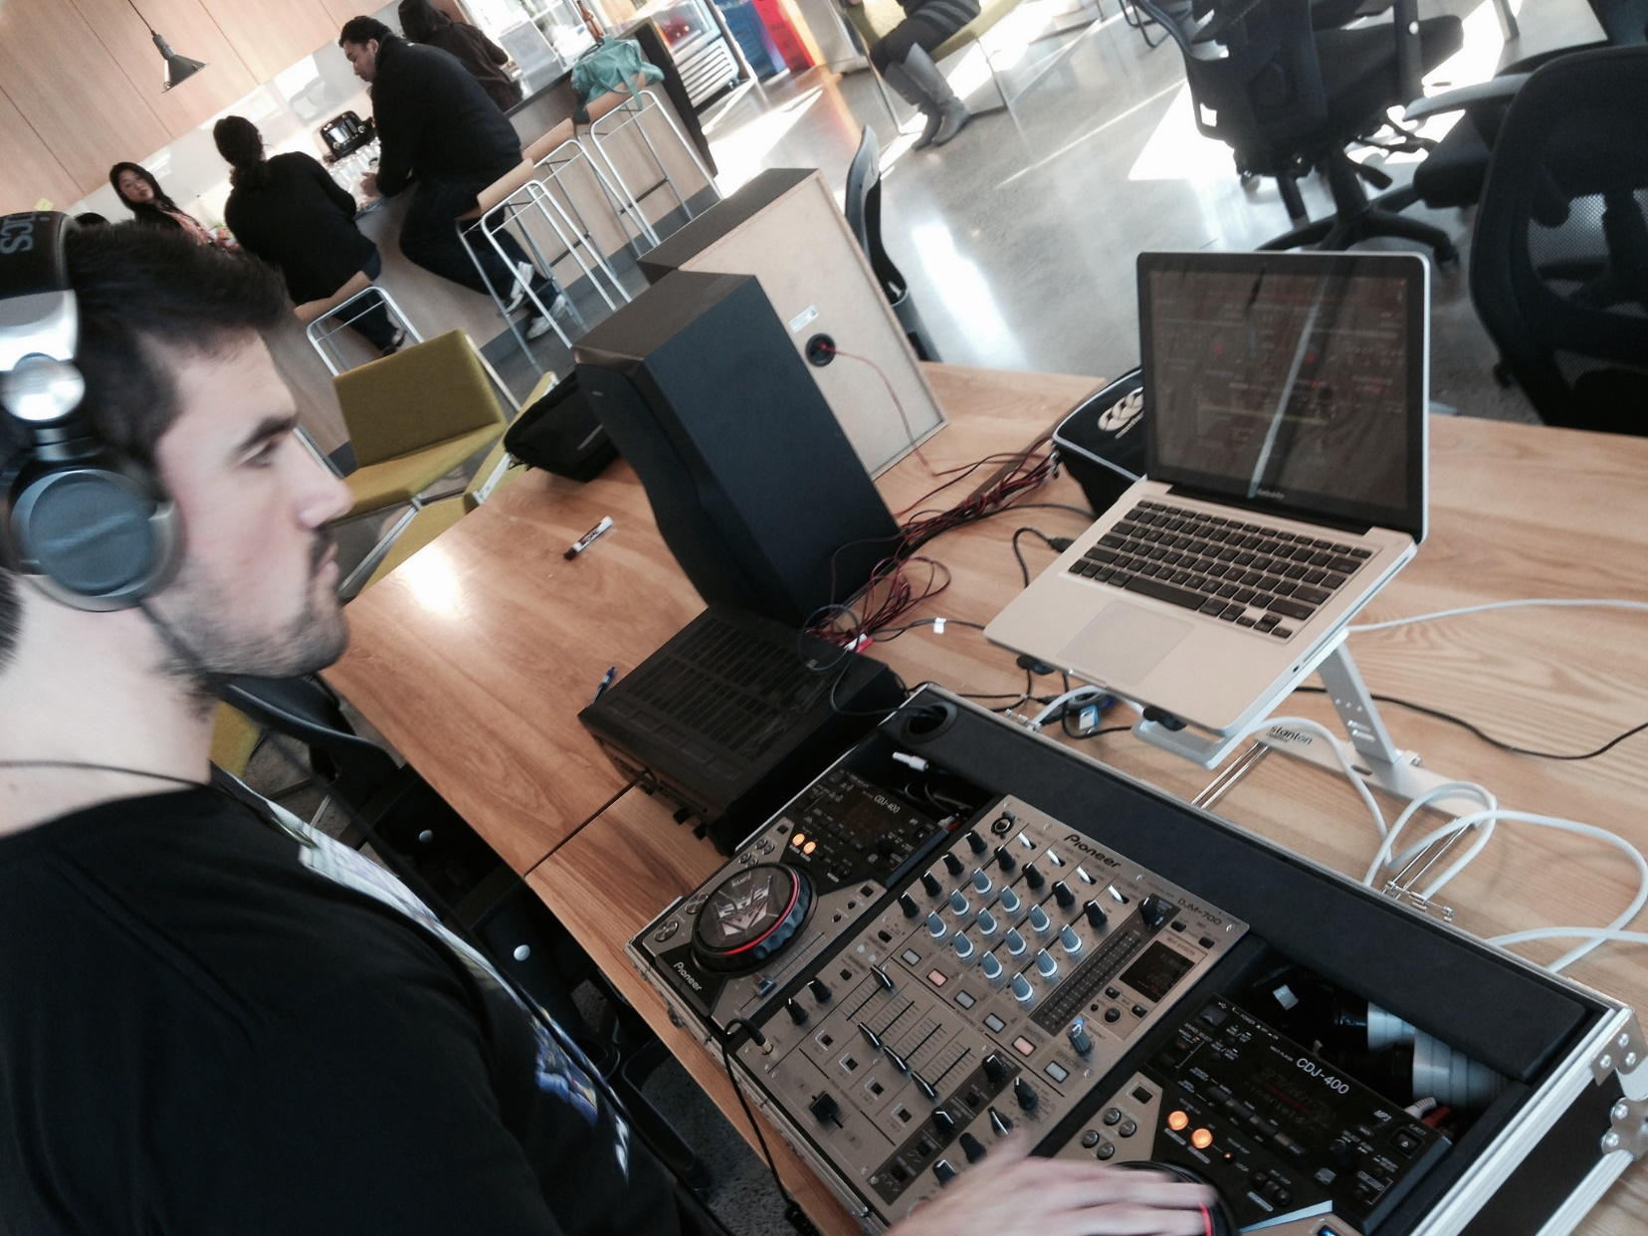

Slide 31
http://en.memory-alpha.org/wiki/Phoenix

Slide 32
By NASA [Public domain], via Wikimedia Commons http://commons.wikimedia.org/wiki/File%3AApollo_11_Earth.jpg

Slide 33
Hacking
(This is not a Security talk)

Slide 34
Hacking is exploration
“The act of engaging in programming in a spirit of playfulness and exploration.
http://en.wikipedia.org/wiki/Hacker_(programmer_subculture)

Slide 35
Hacker enjoys exploring
“A person who enjoys exploring the details of programmable systems and stretching their capabilities.
http://en.wikipedia.org/wiki/Hacker_(programmer_subculture)

Slide 36
What is possible?
“Hacking entails some form of excellence, for example exploring the limits of what is possible, thereby doing something exciting and meaningful.
http://en.wikipedia.org/wiki/Hacker_(programmer_subculture)

Slide 37
